Slide 1
ANN - Lab 2
Tianxiao Zhao
Suping Shi
Feb 8th, 2017

Slide 2
The Lab is about...
Radial Basis Functions (RBFs)
Supervised learning of the network weights
Self-organized learning of the positions of RBF units
Its practical uses

Slide 3
Main Points
Supervised learning of network weights
Batch learning with least squares
Online learning with delta rule
RBF placement
Competitive learning
Expectation maximization
Function approximation

Slide 4
How it works...
Choose units
RBF placement
Competitive learning or
Expectation maximization
Weight calculation
Batchwise least squares or
Online learning with delta rule
RBF network

Slide 5
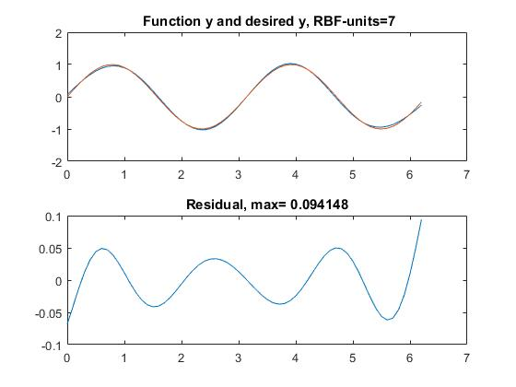
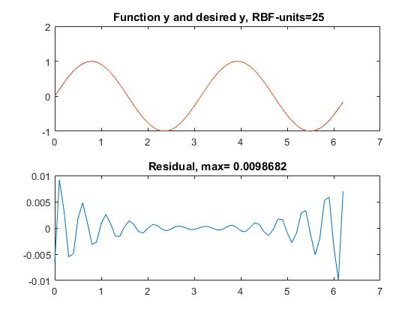
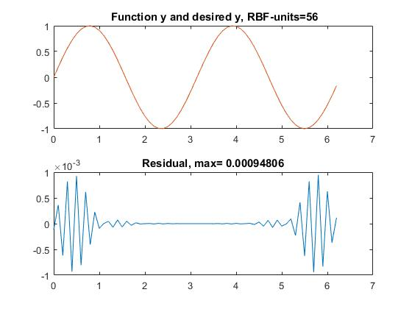
Batch learning using least squares - sin(2x)
Residual < 0.1
Residual < 0.01
More RBF units ---> smaller residual values
Residual < 0.001

Slide 6
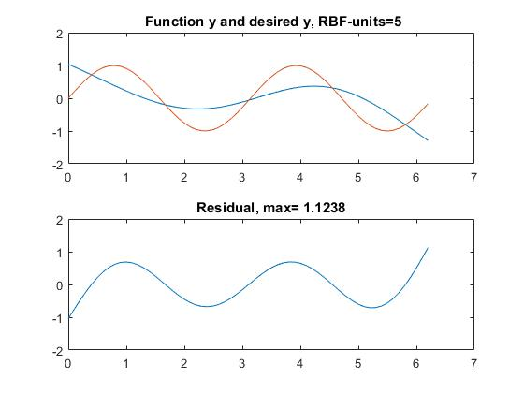
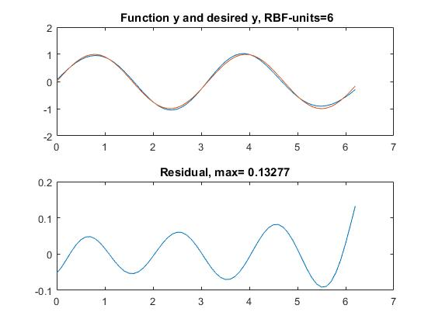
Batch learning using least squares - sin(2x)
units = 5
means | 0 | 1.55 | 3.10 | 4.65 | 6.20
var = 0.6006
units = 6
means | 0 | 1.24 | 2.48 | 3.72 | 4.96 | 6.20
var = 0.3844
units = 5 ---> means of RBFs close to zero-crossings
units = 6 ---> means of RBFs close to peaks or valleys

Slide 7
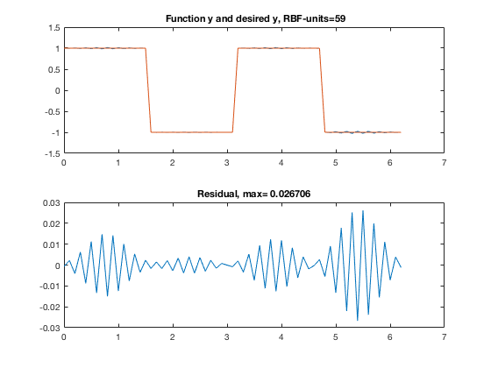
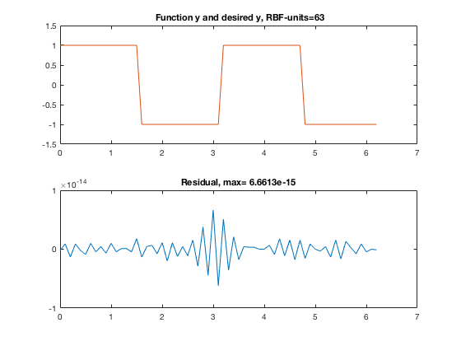
Batch learning using least squares - square(2x)
Residual < 0.1
Residual < 0.01 & Residual < 0.001
More RBF units ---> smaller residual values
Takes more units to achieve the same accuracy than sin(2x)

Slide 8
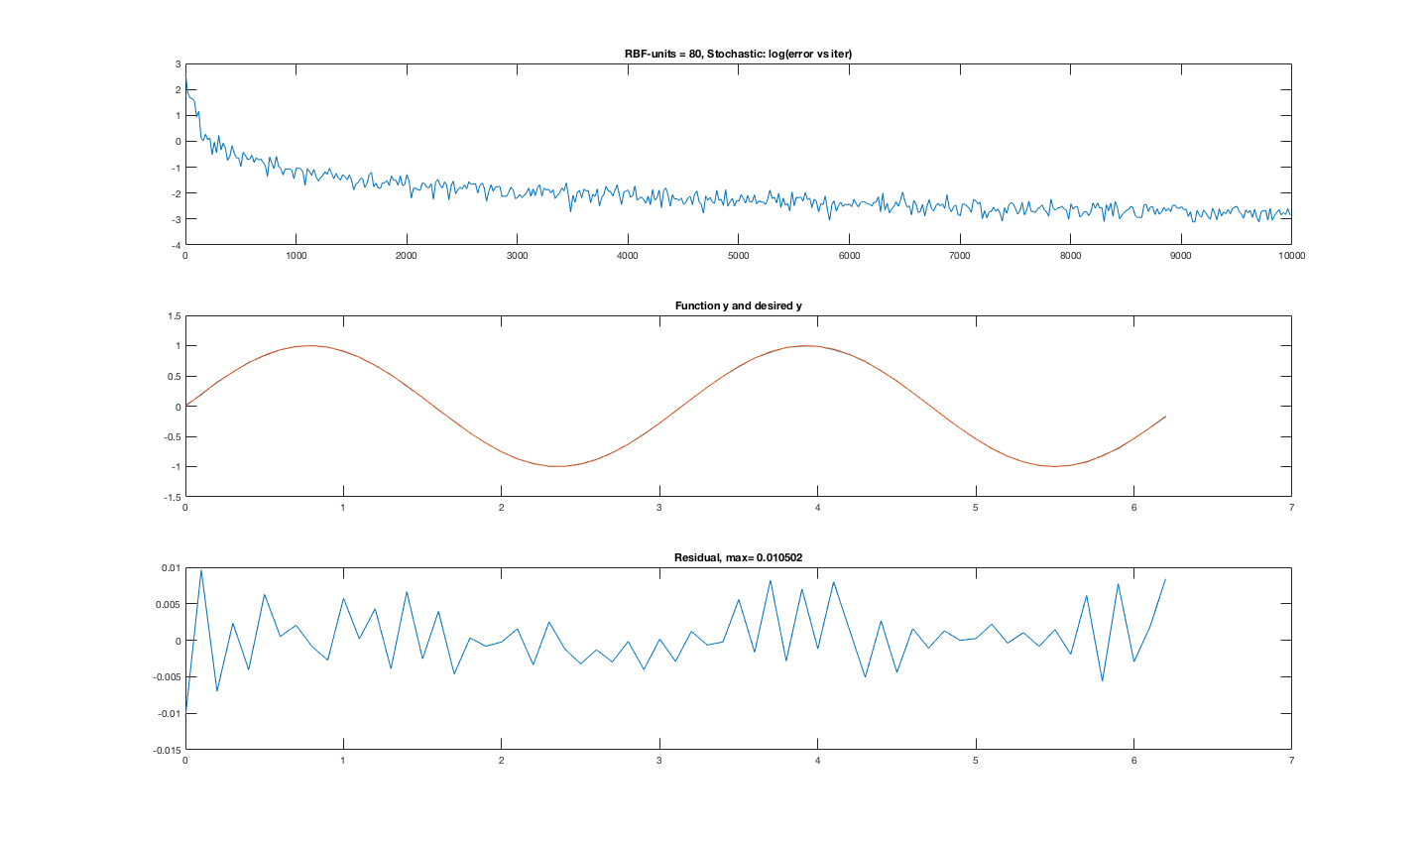
Online learning using delta rule - sin(2x)
Two Eta: one for error lower than threshold (Eta =0.0005 ), another for error above that (Eta = 1.5)
units = 80, iterations = 10000

Slide 9
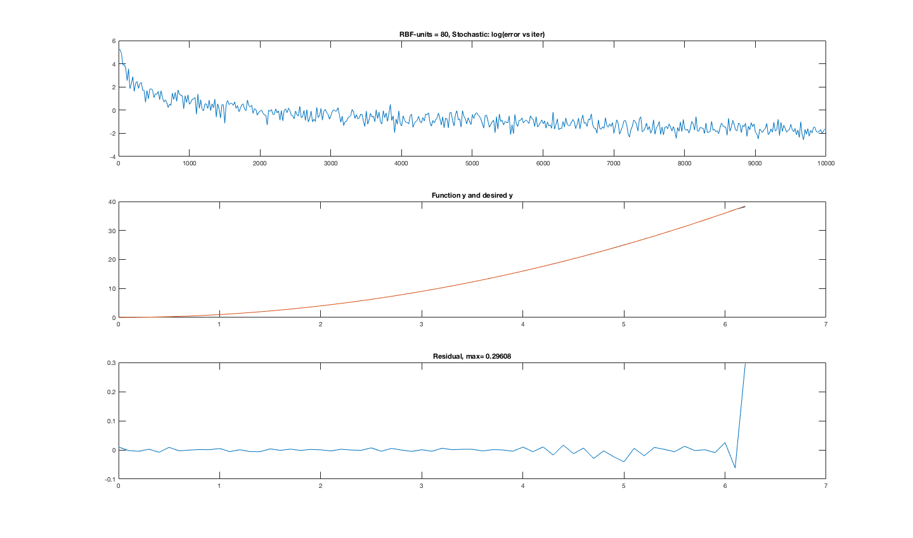
Online learning using delta rule – x^2
Two Eta: one for error lower than threshold (Eta =0.0005 ), another for error above that (Eta = 1.5)
units = 80, iterations = 10000

Slide 10
Self Organization
Competitive Learning: only positions of RBF units are adjustable
Expectation Maximization: positions and widths of units are adjustable
Single winner :
= 1 : ONLY update the winning unit;
= 0 : ALL nodes move;

Slide 11
Competitive Learning
Singlewinner = 1
Singlewinner = 0

Slide 12
Expectation Maximization
Singlewinner = 1
Singlewinner = 0

Slide 13
Winner-take-all
Advantage: converge fast; better generalization
Problem: dead-unit problem:
Prototype vectors far from actual data will never become better.

Slide 14
CL
Singlewinner = 1
Units = 3
Singlewinner = 0
EM

Slide 15
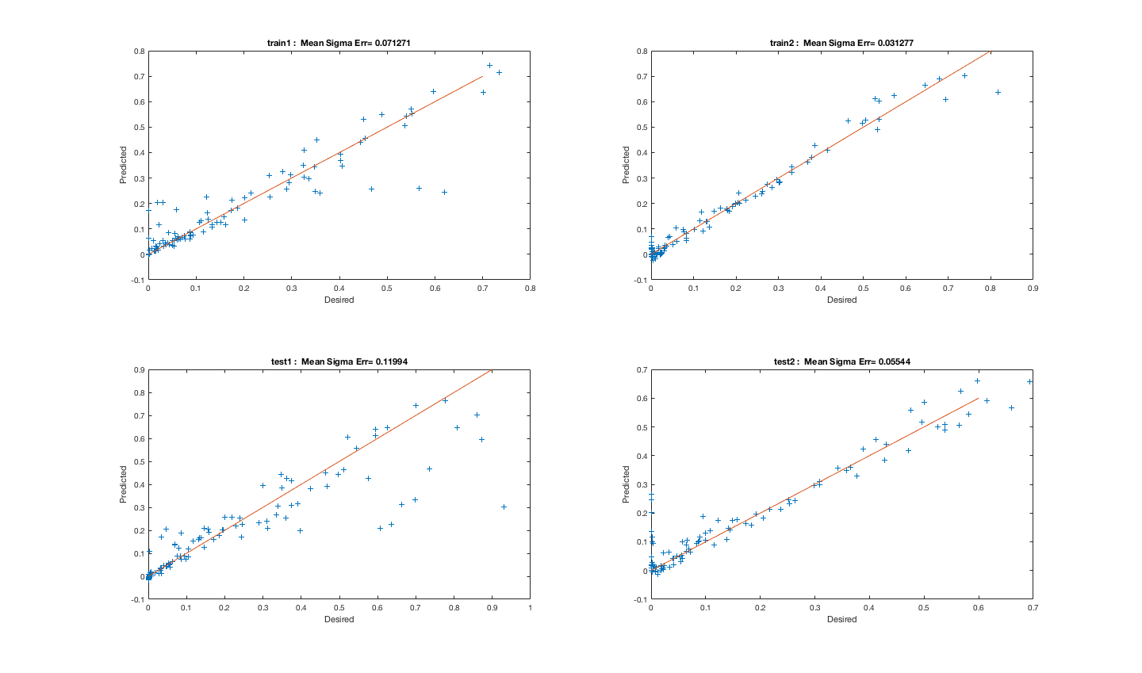
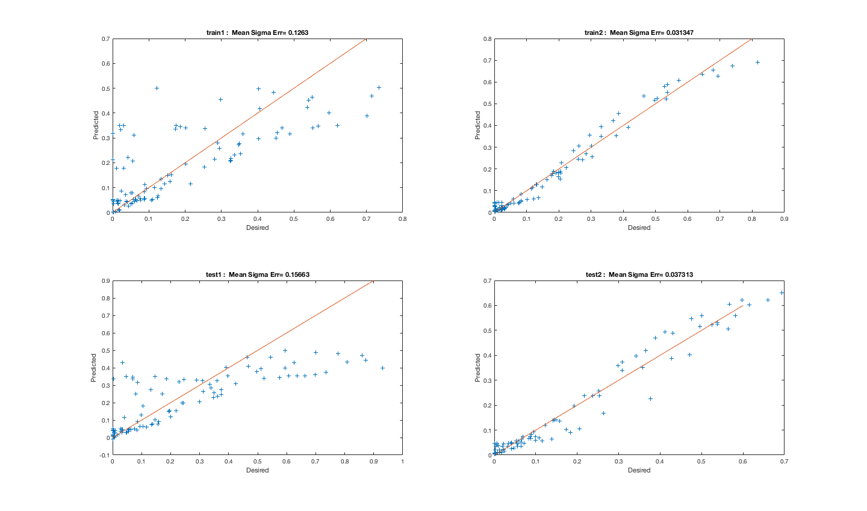
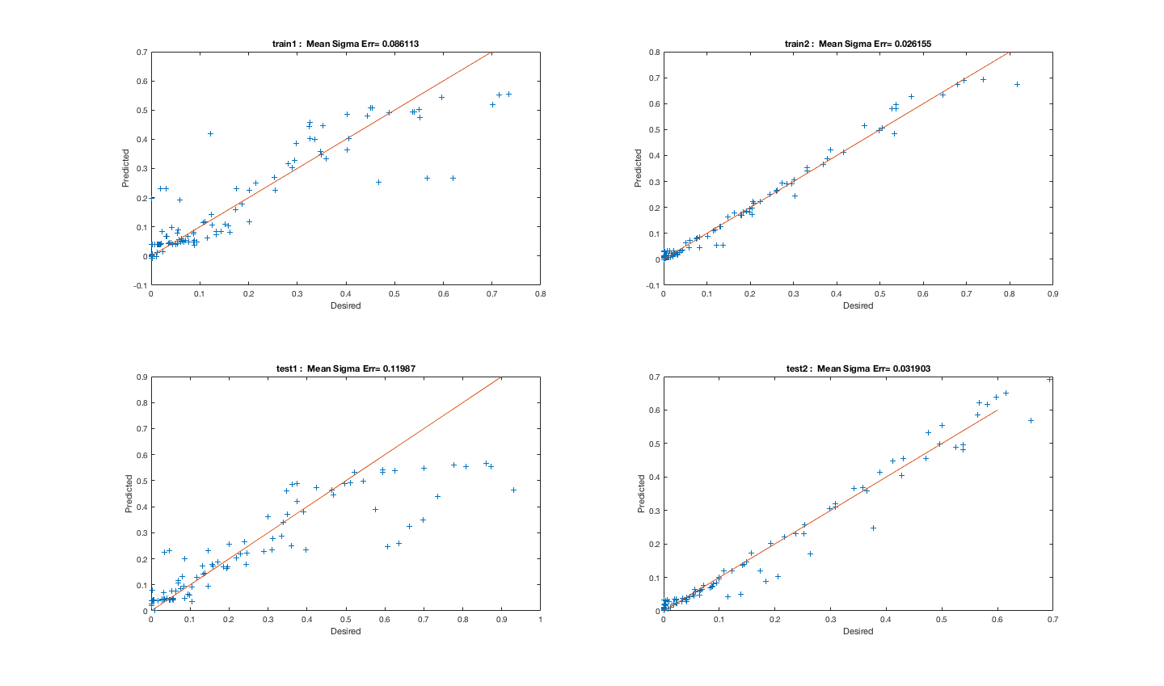
Function approximation for noisy data
units = 20
units = 5
Units 20 ---> 10: minor influence on error
Units 10 ---> 5: error increases
units = 10

Slide 16
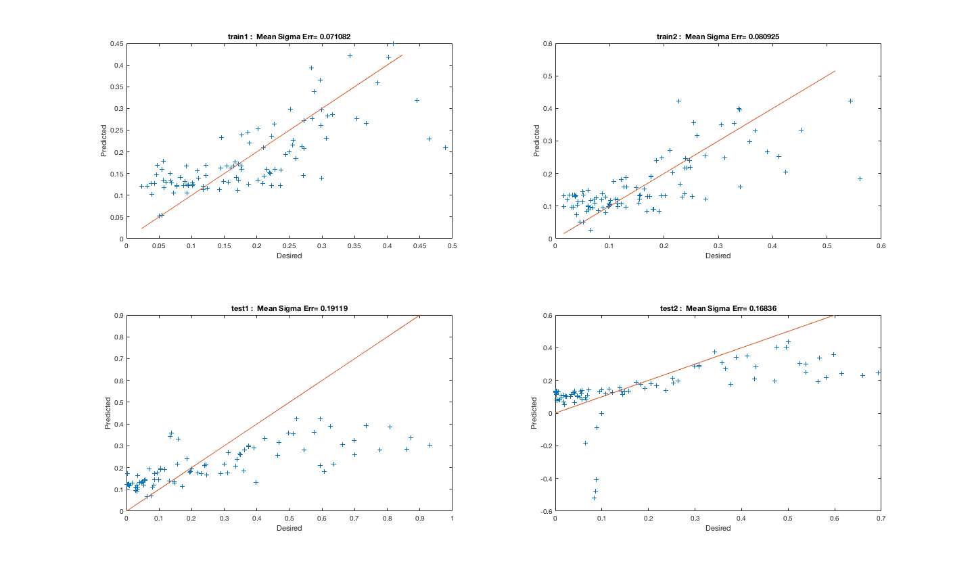
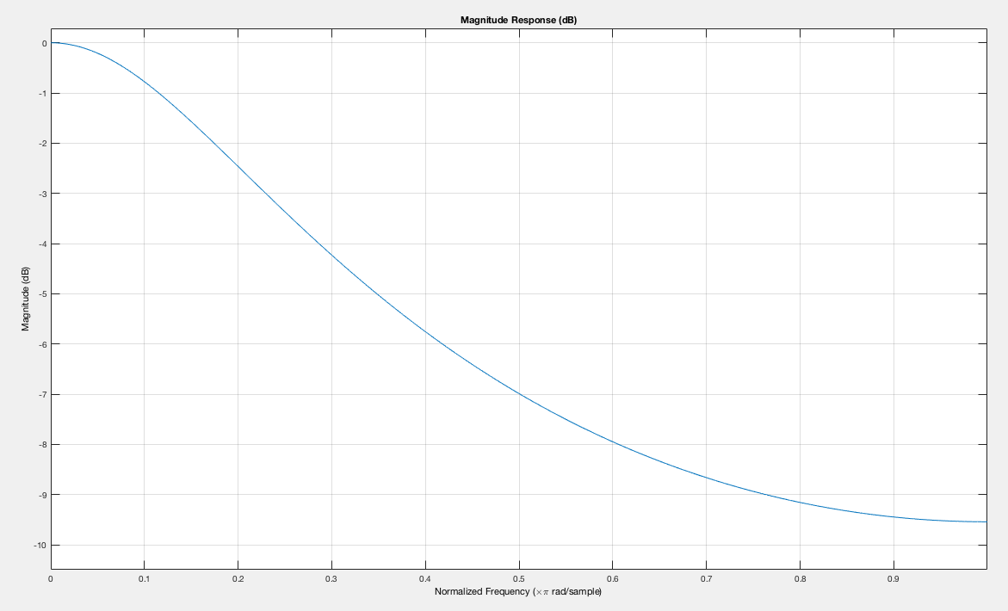
Function approximation for noisy data - lowpass filter
units = 20
units = 20, with lowpass filter
No help!
Could try different cutoff frequency
Not sure where the noise is added
(input or output or input + output)

